Slide 1
Putting on the Full armor of God
In Spiritual Warfare

Slide 2
EPHESIANS 6:10-11 Finally be strong in the lord and in his mighty power. Put on the full armor of god so that you can take your stand against the devil’s schemes.

Slide 3
This presentation will talk about the 7 weapons that make up the full armor of god and why we should use them in spiritual warfare.

Slide 4
Beloved, we have to come to an understanding that god has given us weapons to use in spiritual warfare.

Slide 5
The problem that I see in the body of christ is we don’t know what these weapons are and we do not know how to use them in battle.

Slide 6
Satan knows that most christians do not know about these weapons and uses this fact to his advantage in spiritual warfare.

Slide 7
It is time for us in the body of christ to become educated in engaging in spiritual warfare. This is necessary because we are in a war with satan and his demons. Beloved, remember we are in the end times.

Slide 8
It is important to note that the full armor of god is compared to a roman soldier’s armor.

Slide 9
the first weapon is the belt of truth. In a roman soldier’s armor, the belt holds the sword. This belt is very important as it enables the effectiveness of a soldier’s armor. This belt enables us to carry the sword of the spirit (word of god), and use it correctly in spiritual warfare.

Slide 10
The second weapon is the breastplate of righteousness. Having righteousness is very important in our walk with god. Being righteous is doing what is right in the eyes of god. God’s laws and commandments are righteous. Beloved, we have to remember that lawlessness is sin and god is a god of justice. He will not tolerate sin under any circumstance. Having the breastplate of righteousness means that we are obeying god’s laws which are ultimately laws of love.

Slide 11
The third weapon is the preparation of the gospel of peace. The gospel of peace correlates to the shoes of the roman soldier’s armor. To be effective in spiritual warfare, shoes help us move freely and give our full attention to the battle at large. God wants us to proclaim the gospel of god’s kingdom which ultimately means that the news of salvation will travel around the entire world.

Slide 12
The fourth weapon is the shield of faith. Please note that faith is the substance of things hoped for, the evidence of things not seen (hebrews 11:1). This shield is a deflector against the fiery darts that the devil sends against us. when our faith in god is strong, it is impossible for the devil to get these fiery darts through our shield of faith.

Slide 13
Beloved, when we bring our shields together in the body of christ, we will be undefeated. That is why it is so important that we have unity in the body of christ.

Slide 14
The fifth weapon is the helmet of salvation. Salvation means to be saved from something. Remember, jesus is our savior and he died on the cross for our sins so that we can have eternal life with him. Salvation is a gift from god and cannot be earned. Salvation is a process that is ongoing as it entails god’s laws are written on our hearts and we follow these laws wholeheartedly. This helmet is hope that protects our minds and our hearts from the sufferings and evil of this world.

Slide 15
The sixth weapon is the sword of the spirit which is the word of god. The word of god is a two-edged sword that cuts through every defense that the devil launches against us. This sword is both a defensive and offensive weapon. Using this sword in battle against the enemy helps us to be successful in completing the work that is assigned to us by god.

Slide 16
The last weapon to be discussed is the power of prayer and supplication in the spirit. Prayer is so important and should be an integral part of our daily lives. Beloved, we need to make time for god even though our lives are so busy. We have to put on the full armor of god daily, but we also have to have an open line of communication with our commander in chief, the lord jesus christ.

Slide 17
Remember that prayer changes things, first in the spiritual realm and then in the physical realm. That is why it is so powerful!!!

Slide 18
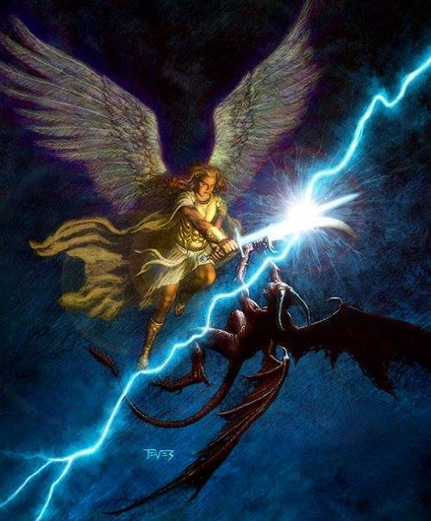
Beloved, remember satan is a defeated foe. We have the victory through our lord and savior jesus christ. The battle is ours!!!

